Slide 1
Understanding Customer Purchase Patterns

Slide 2
Product Co-Occurrence Probability Analysis
Calculated how often products are purchased together using co-occurrence probabilities
Heatmap to show strong product associations, helping businesses with bundling strategies

Slide 3
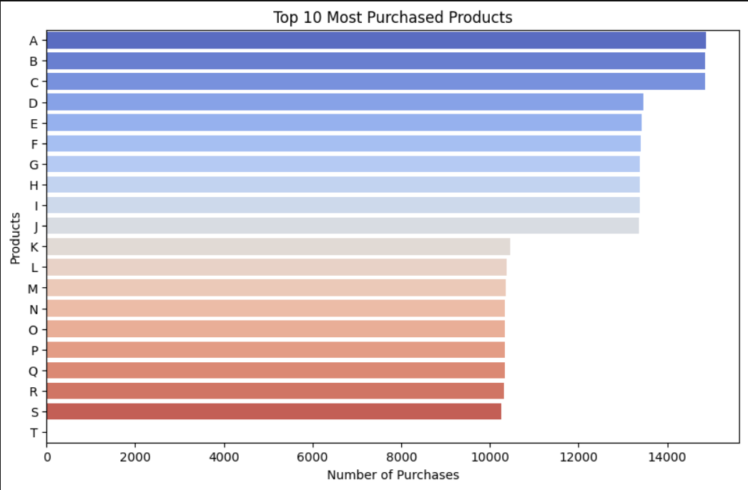
Most purchased items

Slide 4
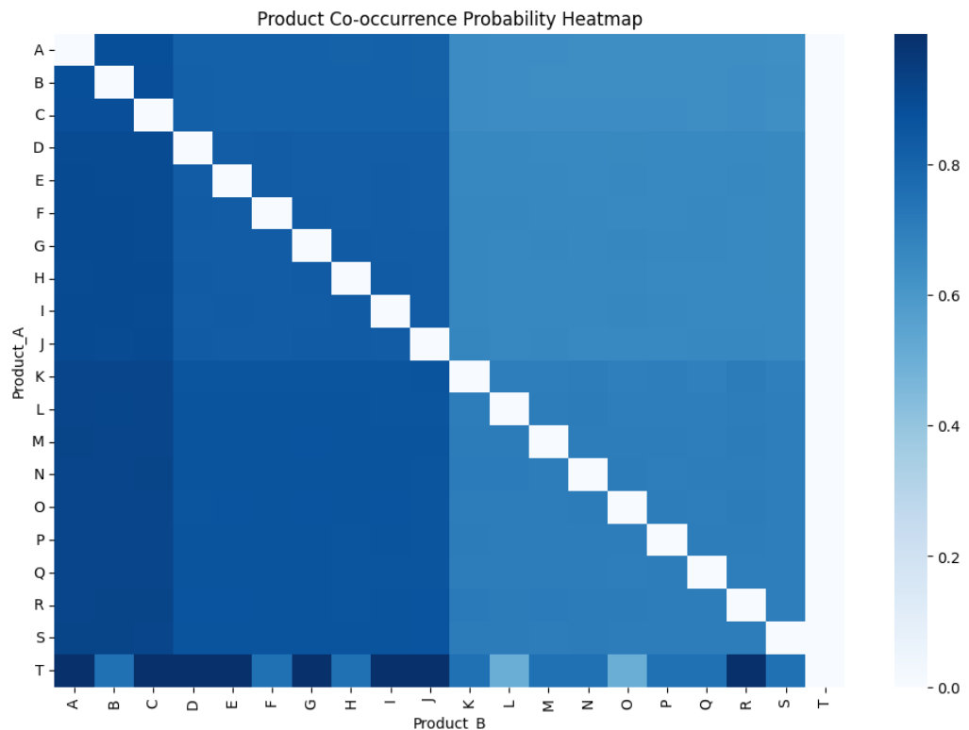
Probability Heatmap

Slide 5
Short Code Mapping:
A: VisionX 4K Webcam
B: GlideTouch Stylus Pen
C: HexaHome Smart Lock
D: PowerCube Solar Bank
E: Velocity Gaming Mouse
F: Ultrabyte SSD 1TB
G: Pulse Fitness Tracker
H: Titan Gaming Monitor
I: Nexus Wireless Charger
J: Eclipse Noise-Canceling Headphones

Slide 6
K: NanoShield Phone Case
L: FlexCharge USB Hub
M: NeoX Smartwatch
N: Thunderbolt Gaming Keyboard
O: CyberGear VR Headset
P: Quantum Laptop Pro
Q: AeroMax Wi-Fi Router
R: ProSync Cloud Storage S: Xtreme Bluetooth Speaker
T: AeroDrone X2244

Slide 7
Key insights from the top 10 co-occurrence pairs
VisionX 4K Webcam (A) frequently co-occurs with C, B, E, making it a core product in bundles
AeroDrone X2244 (T) has a 100% probability of being purchased with several items, suggesting it's often bought as part of a package
HexaHome Smart Lock (C) & GlideTouch Stylus Pen (B) have the highest co-occurrence
ProSync Cloud Storage (R) has a 92.3% probability of being purchased with HexaHome Smart Lock (C), This suggests that customers investing in smart home security are also interested in cloud-based data storage for security footage or access logs
Pulse Fitness Tracker (G) & GlideTouch Stylus Pen (B) appear together frequently, indicating that tech-savvy customers or professionals interested in stylus pens also prefer smart wearables

Slide 8
Business Recommendations for Optimization
Create Product Bundles & Discounts: Bundle VisionX 4K Webcam (A) with Smart Locks (C) and Stylus Pens (B) to increase sales.Offer discounts on commonly co-purchased products to boost revenue
Optimize Cross-Selling Strategies: Recommend co-occurring products during checkout (e.g., customers buying the Smart Lock (C) should be shown the Stylus Pen (B)).
Stock & Inventory Management: Ensure high-demand product pairs (A, B, C, and E) are always in stock to avoid missed sales.
Focus on highest selling one: Forecast demand for T (AeroDrone X2244) since it is always bought with multiple products.

Slide 9
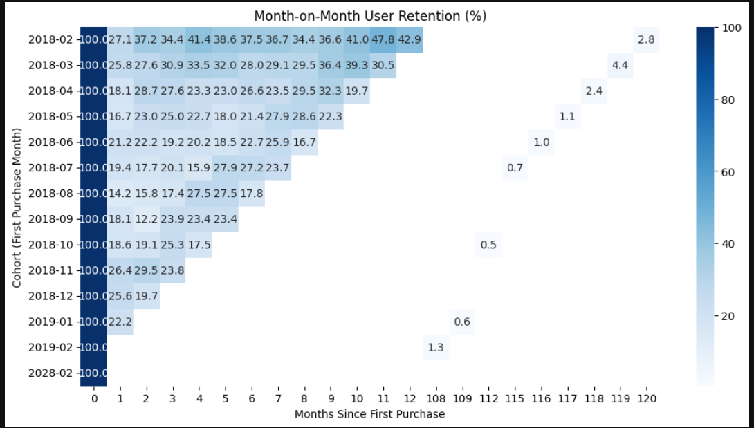
Churn & Retention Cohort Analysis

Slide 10
Insights from heatmap
Most cohorts start with 100% in the first month but quickly drop to 20-40% in the next few months
Beyond 6 months, retention drops significantly, with very few cohorts maintaining above 30%.
Some months show slight increases later, possibly due to efforts put by sales and marketing team

Slide 11
Strategies to Improve Retention
Ensure users see immediate value after their first purchase.
Implement tailored email marketing, push notifications, and in-app messages to re-engage users based on their activity
Analyze why users leave by conducting surveys and reviewing customer behavior
Offer special incentives for frequent customers and advertise it
Create a community where users can share experiences
Implement remarketing ads targeting past users

